Slide 1
Advisory Board for Club Sports

Slide 2
Mission and Purpose
To facilitate and support the Club Sports community of Georgetown University
Accepting and welcoming all on this competitive and exclusive campus
Cura Personalis (Care of the whole person) - supplement academics with active extracurriculars

Slide 3
Organization
Currently we have 34 club sports (FY19)
35th sport - Skiing (FY 20)
Ranging from water and ice sports to horse sports and team sports
We continue to grow every year.
Two teams added this fiscal year (Wrestling and Table Tennis with TT women’s making regionals in its first year)

Slide 4
Projects
Kehoe Field Project
is supposed to be complete for the ‘19-20 school year (Fall 2019)
Will allow for us to minimize the field space usage off campus (Visitation and Duke Ellington)
But we will be sharing the space with Intramurals
Training Office
Athletic Trainers office was finished this fiscal year
Dues Assistance Program (DAP)
Used to help students who want to participate but do not have the financial means to do so
Financial concern should not hinder you from participating
1st year it has been successful where students take advantage

Slide 5
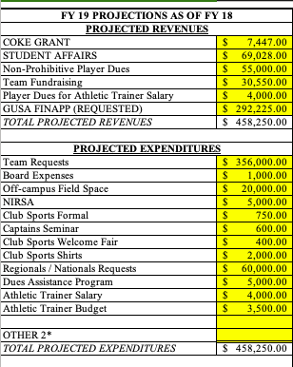
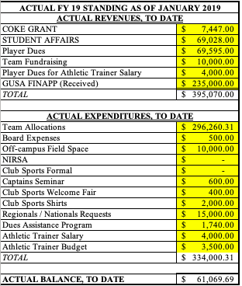

Slide 6
Budget
Request: $309,755.00
This year team dues was on average of $152 and we hope to reduce that to $100 on average
Hope to have 1000 members next fiscal year (with the addition of the new teams)
Dues Assistance Program
Proved to be very beneficial this year and we would like to continue the program
Team budget requests for funding increases every year
The price change for horse stables (clubs) and ice rinks
8 teams that are allocated over $10,000

Slide 7
Budget cont.
Nationals and Regionals Request Form
Avg funding request - $5700
ABCS funds max - $3000
Would like to increase the max request $4500
Flights are not funded
Limited 1 request per fiscal year
So either nationals or regionals if you qualify for both

Slide 8
Reserves
Has been reduced by about $150,000 over the last few years
Additional field space off campus
Athletic trainer salary
Needed
Unexpected costs (one-time) that teams might incur
New clubs from NCD
Additional funding to teams running low

Slide 9
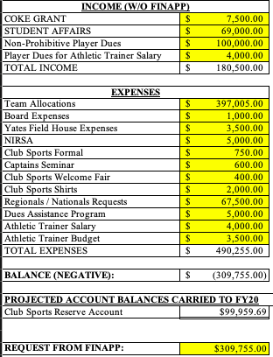

Slide 10
Request
The amount requested would allow for us to be able to:
Reduce the average team dues by $50
Able to financially assist members of the higher dues teams (DAP)
Close the gap between nationals.regionals average request and maximum funding
Prepare for any additional teams through NCD
Meet most if not all team funding requests
Which increases yearly
The number of teams that are allocated over $10,000 is increasing

Slide 11
Questions?

